Slide 1
PART -2

Slide 2
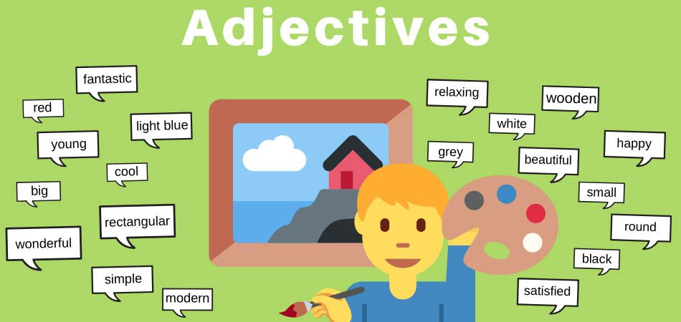

Slide 3

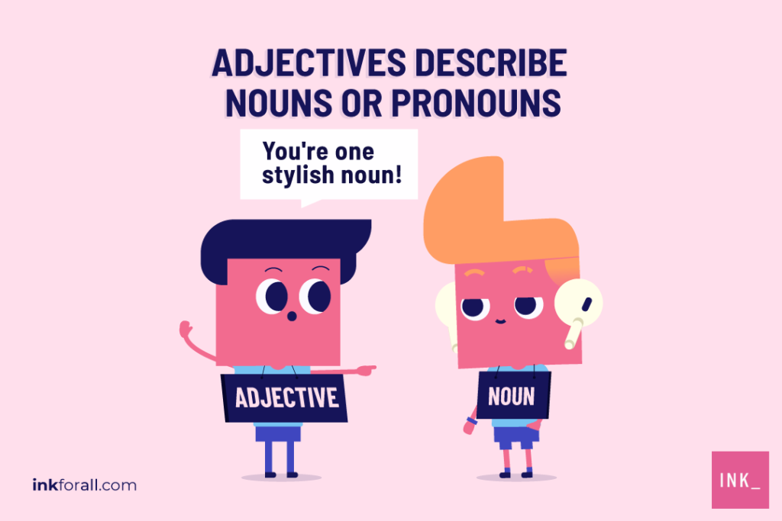
Adjective
An adjective
describes or modifies noun/s and pronoun/s in a sentence. It normally indicates quality, size, shape, duration, feelings, contents, and more about a noun or pronoun.

Slide 4
It usually answers the question of which one, what kind, or how many.
The team has a dangerous batsman. (What kind?)
I have ten candies in my pocket. (How many?)
I loved that red car. (Which one?)
I earn more money than he does. (How much?)

Slide 5
Positioning of an adjective in a sentence.
Before a noun –
She has a beautiful handwriting.
My cake should have sixteen candles.
After a verb –
Her handwriting is beautiful.
It smells gross in the locker room.
Driving is faster than walking.

Slide 6
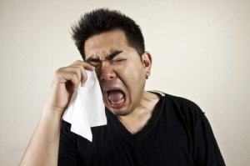
Poll Question:- Choose the correct adjective for this image:
A. helpful
B. sensitive
C. sociable
D. organized

Slide 7



Answer
Option-B

Slide 8
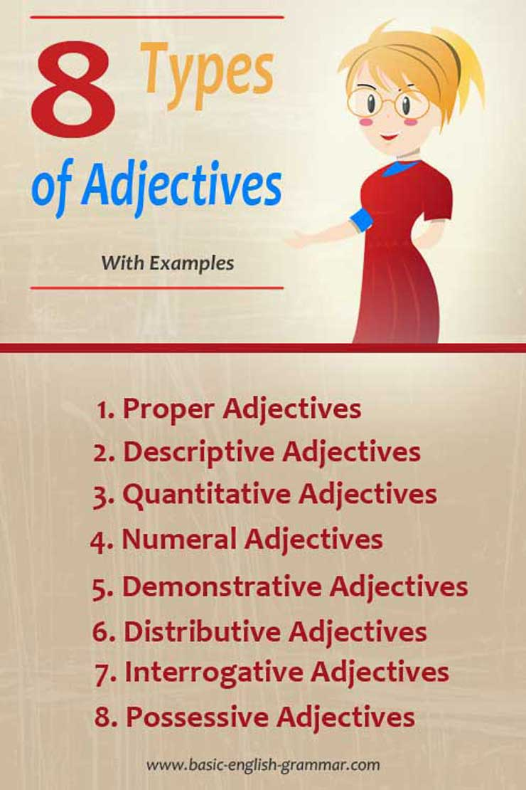

Slide 9
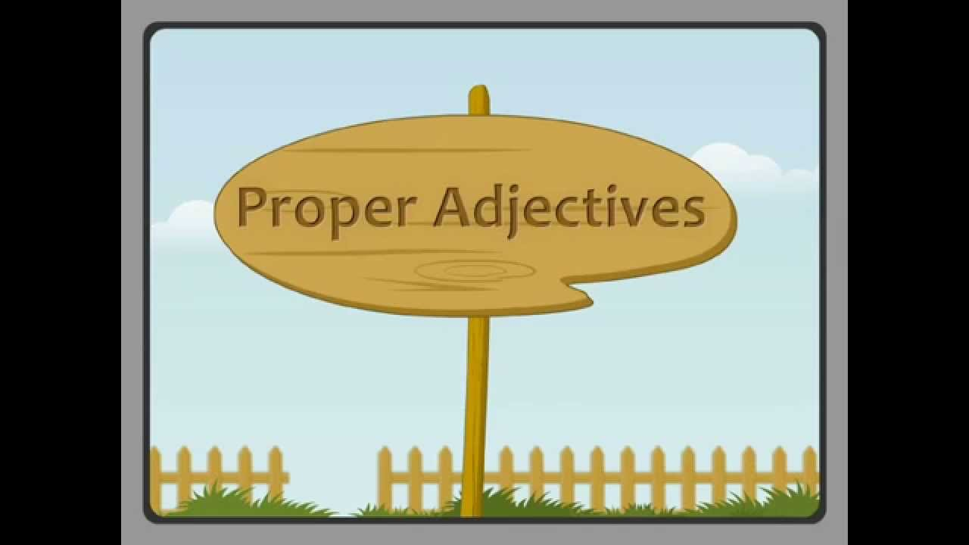
Proper Adjective
An adjective formed from proper noun, particularly from names of geographical places is called proper adjective. It is spelled with a capital letter.

Slide 10
For Example:-
I live in japan ( proper noun) and I love Japanese ( proper adjective ) food.
This is swiss cheese.
We drink Assamese tea.
He eats Russian caviar.
The British council rejected the new law.

Slide 11
Poll Question:-
A proper adjective is formed from a proper noun.
A. True
B. False

Slide 12
Answer
Option- A

Slide 13

Descriptive or attribute Adjective
These adjectives describe nouns or pronouns. They show the quality of a person or thing the noun names. Such adjectives Supply an answer to the question of ‘WHAT KIND’?

Slide 14
For Example:-
Mohan’s drawing is amazing.
We had a fantastic trip last year.
The lotus is a beautiful flower.
Delhi is a crowded city.

Slide 15
Poll Question:-
Adjectives that tell about the size, shape, color, or weight of the things they describe are called ____________ adjectives.

Slide 16
Answer
Descriptive

Slide 17
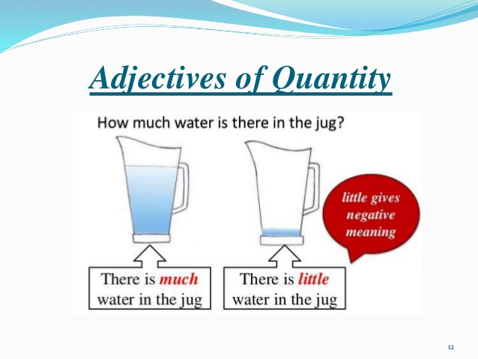
Quantitative Adjective
It describes the number or quantity of noun or pronoun.
Generally, they answer the question ‘HOW MUCH’?

Slide 18
For Example :-
I have only few balloons to decorate the house.
She ate the whole watermelon.
Jonathan drank little water during the marathon.
He has sufficient tenacity.
The scientists didn’t have much time to complete the project.

Slide 19
Poll Question:-
In this sentence identify the adjective:
My cake should have sixteen candles.
A. cake
B. candles
C. sixteen
D. have

Slide 20
Answer
Option- C

Slide 21
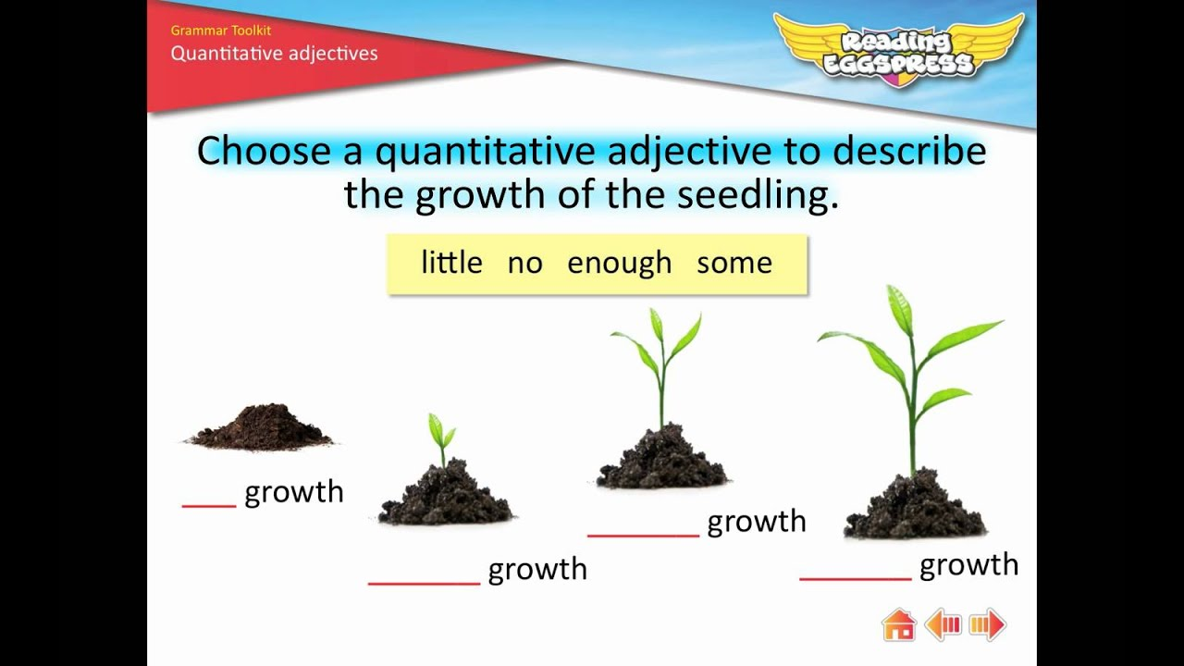
Activity

Slide 22
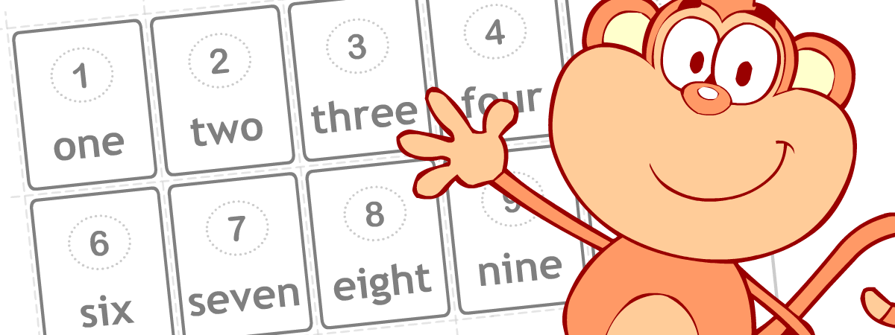
Numeral Adjective
A numeral adjective is an adjective that tells us about how many or how much or in what order the noun is in.
:

Slide 23
For example.
There are seven days in a week.
I have two tins of paint in the shed.
Rachel bought three dresses at the shopping mall.
Brad was the first student to receive an award for the best player at the games.

Slide 24
There are three kinds of numeral adjectives:
Definite numeral adjectives use cardinal (numbers used in an amount) and ordinals (numbers used as an order).
i.e., The sixth applicant performed well.
Indefinite numeral adjectives give us an idea as to how many, but it's not specific.
i.e., I have some considerations to discuss with you.
Distributive numeral adjective tell us something about the group.
i.e., Each hand has five fingers.

Slide 25
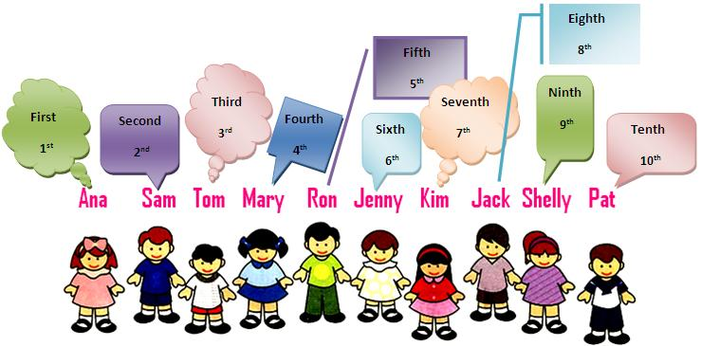

Slide 26
Poll Question:- Choose the correct option.
What kind of an adjective is 'several’?
A. Definite Numeral Adjective
B. Indefinite Numeral Adjective
C. Distributive Numeral Adjective

Slide 27
Answer
Option- B

Slide 28

Demonstrative Adjective
A demonstrative adjective (this, that, these, those) shows the noun it modifies is singular or plural and whether the position of the noun is near or far from the person who is speaking or writing. A demonstrative adjective also points out a fact about the noun.

Slide 29
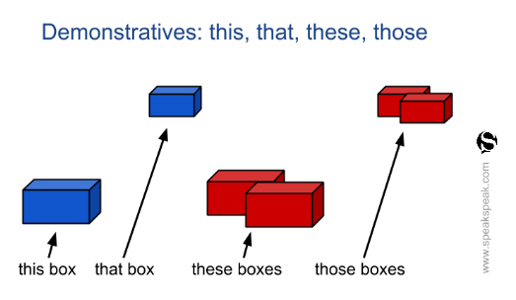

Slide 30
For Example:-
Give me that blue water bottle.
This time I won’t fail you.
I want those gorgeous marbles.
I wanted to propose you that day.
These mangoes are rotting.

Slide 31
Note:- Demonstrative adjectives describe nouns or whereas demonstrative pronouns replace nouns.
Examples of Demonstrative Adjectives and Pronouns in the same sentence.
These (adjective) are sharper than those.(pronoun)
This (adjective) watch is mine but that (pronoun) is not.

Slide 32
Poll Question:-
When do we use "that"?
A. When the thing is far
B. When the things are far
C. When the things are near
D. When the thing is near

Slide 33
Answer
Option-A

Slide 34


Slide 35
Distributive Adjectives are words used to refer to members of a group as individuals.
There are only four Distributive Adjectives (each , every, either, neither)
Either side of the river is safe.
Neither person had the strength to lift the required weighs.
Every student was asked to keep their desk tidy.

Slide 36
Poll Question:-
Which of the following is not an example of distributive pronoun?
A. each
B. every
C. each- other
D. either

Slide 37
Note:- Don’t confuse distributive adjectives and pronouns. Pronoun take the place of nouns. Adjectives modify nouns
Each request will be given careful consideration.(adj)
We can each choose our own subject for research.(pronoun)
Neither Program was printed correctly.(adjective)
There were two witness, but neither would make a statement.(pronoun)

Slide 38
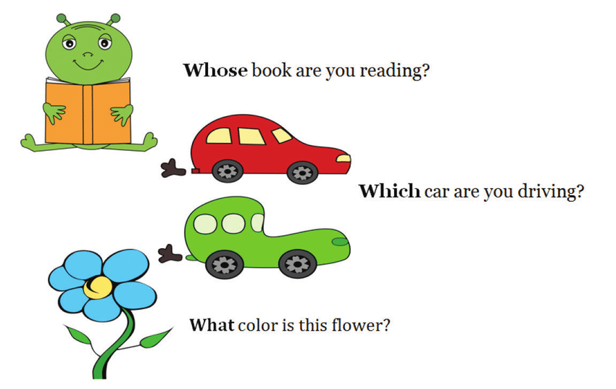
Interrogative Adjective.
These adjectives are used to modify nouns by asking questions.
Here are three interrogative adjectives. (what, whose, which)

Slide 39
Poll Question:- Choose the correct option.
Where are you going? What is 'where' here?
Interrogative Pronoun
Interrogative Adjective
Both
D. None of these

Slide 40
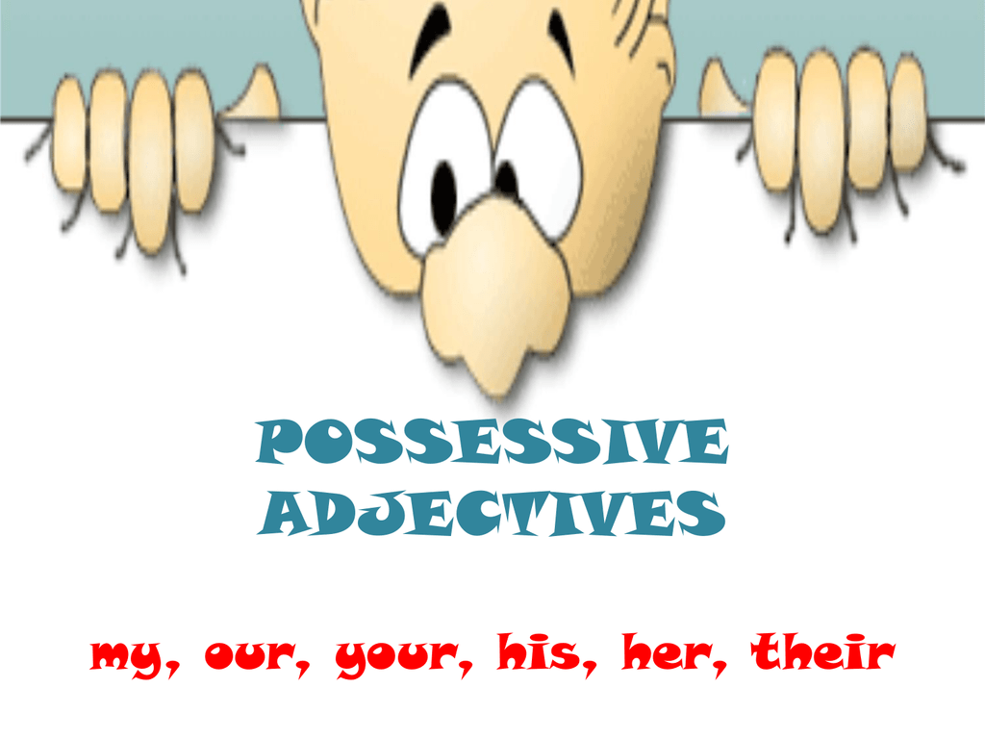

Slide 41
Possessive Adjective are words that sit before nouns to show ownership.
Here are some common possessive adjectives: ( my , your, his , her , its , our , their)
Examples:-
I walked to my school this morning.
We kicked the ball in their backyard.
He put her money in a safe place.

Slide 42
Possessive adjectives, possessive pronouns
Singular
my, mine | It's my dog. This dog is mine. | my = possessive adjective mine = possessive pronoun
your, yours | It’s your book. It’s yours. | your = possessive adjective yours = possessive pronoun
Plural
our, ours | This is our car. This car is ours. | our = possessive adjective ours = possessive pronoun
your, yours | Your baby is beautiful. Which house is yours? | your = possessive adjective yours = possessive pronoun

Slide 43
Poll Question
Possessive adjectives
A. describe people's feelings.
B. tell you who owns something or describe a relationship between people or things.
C. describe people's physical characteristics.
D. tell you what someone is doing.

Slide 44
Answer
Option- B

Slide 45
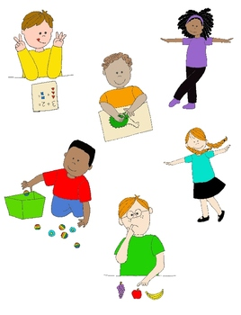
VERB
A verb is a word that conveys an action (bring, read, walk, run, learn) an occurrence (happen, become) or a state of being (be, exist).

Slide 46
In a sentence there is a main verb and sometimes one or more helping verbs.
Example:
She can sing.
Sing is the main verb; can is the helping verb.
Rahul and Sam are cooking dinner tonight.
Are is the helping verb; and cooking is the main verb
Verbs also take different forms to express tense. They take the required forms: they are conjugated accordingly.
Example: The calf ran after the cow.

Slide 47
A verb must agree with its subject in number (both are singular or both are plural).
Singular subject takes singular verb;
Plural subject takes plural verb.
When ‘s’ is added to a verb it becomes singular.

Slide 48
Example:
She eats food very hastily.
Subject: she singular
Verb: eats - singular
The boys were playing Football.
Subject: the boys- Plural
Verb: were playing- Plural

Slide 49
Poll Question: Choose in which of the following sentence , singular verb is used?
A. I love to play football.
B. We play tennis.
C. He likes to play football.
D. They like to play football.

Slide 50
Answer
Option -C

Slide 51
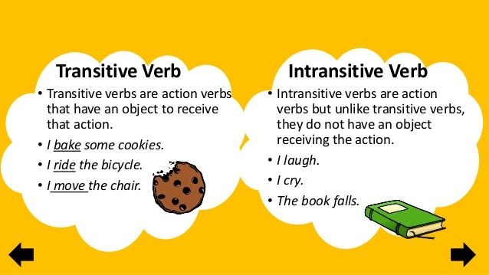

Slide 52
Poll Question:-
An intransitive verb is one that is used with an object
A. True
B. False

Slide 53
Answer
Option- B

Slide 54
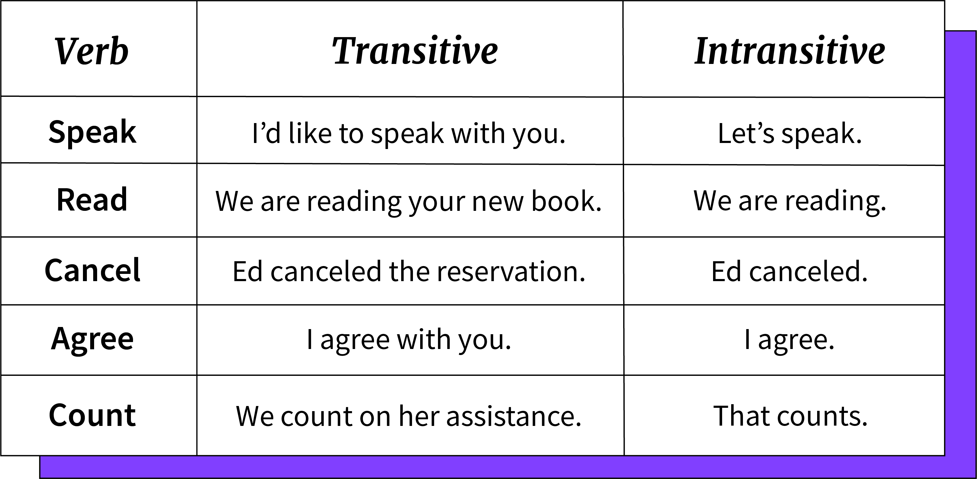

Slide 55
Note:-
There can be indirect objects after the intransitive verbs.
Example: He sleeps in the bed.
The bed – indirect object.

Slide 56
Poll Question:-
Transitive verbs have a direct object.
A. True
B. False

Slide 57
Answer
Option- A

Slide 58


Slide 59
Conjugation of Verbs
Base Form | be | Do | Have
Present | is/ am/ are | do/ does | Has
Past | was/ were | Did | Had
Infinitive | to be | to do | to have
Present Participle | Being | Being | Having
Past Participle | Being | Done | Had

Slide 60
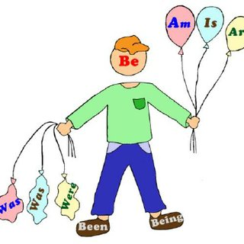

Slide 61


Slide 62
Regular Verbs
In regular verb forms we can add -d or -ed at the end of its base form. The present participle is formed by adding -ing to the base form and the past is formed by adding -ed. If the base form verb ends with the letter -e, we can add only -d for past form verb and remove the -e then just add -ing for the present participle.
Present | Past | Past Participle | Present Participle
Book | Booked | Booked | Booking
Erase | Erased | Erased | Erasing

Slide 63
When a verb ends with a vowel followed by a consonant, the last consonant is doubled before adding - ing or –ed.
Present (V1) | Past (V2) | Past Participle (V3) | Present Participle
Allot | Allotted | Allotted | Allotting
Bat | Batted | Batted | Batting

Slide 64
Irregular Verbs
Irregular verbs with similar present, past and past participle form.
Present Tense | Past Tense | Past Participle | Present Participle
Beset | Beset | Beset | Besetting
Broadcast | Broadcast | Broadcast | Broadcasting
Burst | Burst | Burst | Bursting

Slide 65
Irregular verbs with similar past and past participle forms.
Present Tense | Past Tense | Past Participle | Present Participle
Behold | Beheld | Beheld | Beholding
Beseech | Besought | Besought | Beseeching

Slide 66
Irregular verbs with similar past and present participle forms.
Present Tense | Past Tense | Past Participle | Present Participle
Come | Came | Come | Coming
Overcome | Overcame | Overcome | Overcoming

Slide 67
Irregular verbs with three distinct forms.
Present | Past Tense | Past Participle | Present Participle
Arise | Arose | Arisen | Arising
Awake | Awoke | Awoken | Awakening
Blow | Blew | Blown | Blowing
Choose | Chose | Chosen | Choosing
Do | Did | Done | Doing

Slide 68
Vowels change from ‘i’ to ‘a’ to ‘u’.
Present | Past | Past Participle
Begin | Began | Begun
Drink | Drank | Drunk
Ring | Rang | Rung
Shrink | Shrank | Shrunk

Slide 69

Poll Question:- Choose the correct option.
The verb given in the picture is a__________
A. regular verb
B. Irregular verb

Slide 70
Answer-
Option- B

Slide 71
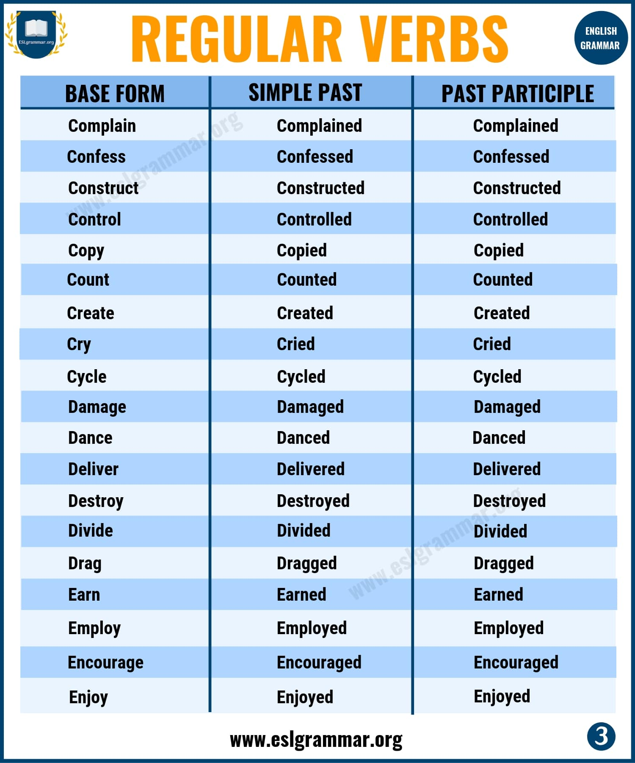
Regular Verbs

Slide 72
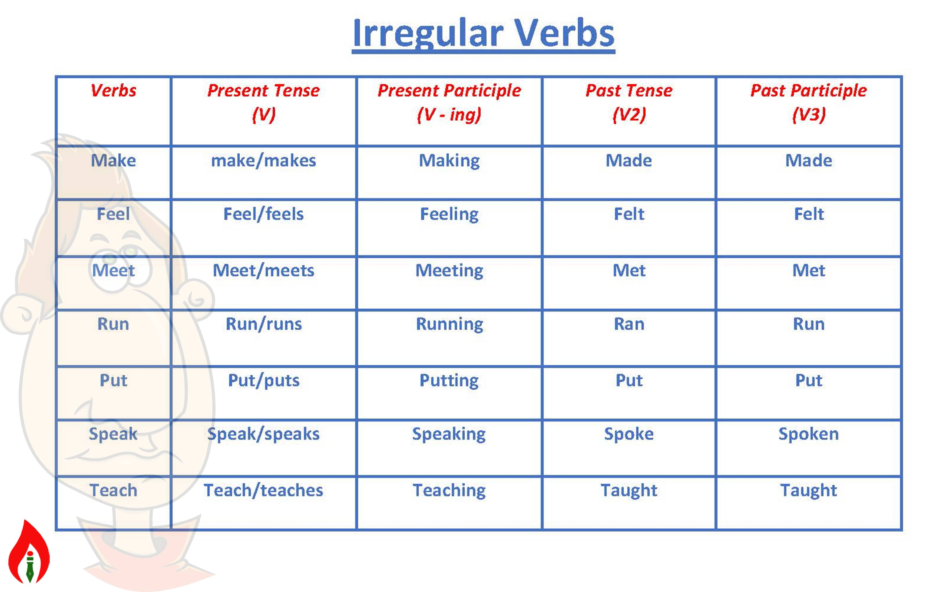

Slide 73

Activity- Choose the irregular verb from the given picture and conjugate the same.

Slide 74
“Practice makes progress.”
Thank You

